Slide 1

Gone Sin Mal
Eat More Pay Less
Team Bit Geeks
Su Pyae Thu Ya, Aung Phone Kyaw, Min Thu Khant
Khant Ti Kyi, Yune Nadi Oo, Myo Thiha Tun

Slide 2



01
Documentation
Report and Diagram.
02
Mobile App
Front End
Back End
Context
03
API
Data Base. API
04
Testing
Test Case. Test Plan. Report

Slide 3
Project Time Line
 | Time | State | Percentage
Project Planning | 7/3/2018-7/7/2018 | Complete | 100%
Requirement Analysis | 7/8/2018-8/11/2018 | Complete | 100%
Design | 8/11/2018-9/8/2018 | Complete | 100%
Coding | 9/9/2018-10/13/2018 | Still Develop | 60%
Testing | 10/14/2018-11/11/2018 | Incomplete | 0%
Debug | 11/13/2018-12/16/2018 | Incomplete | 0%
Customer Support | 12/18/2018-1/3/2018 | Incomplete | 0%

Slide 4
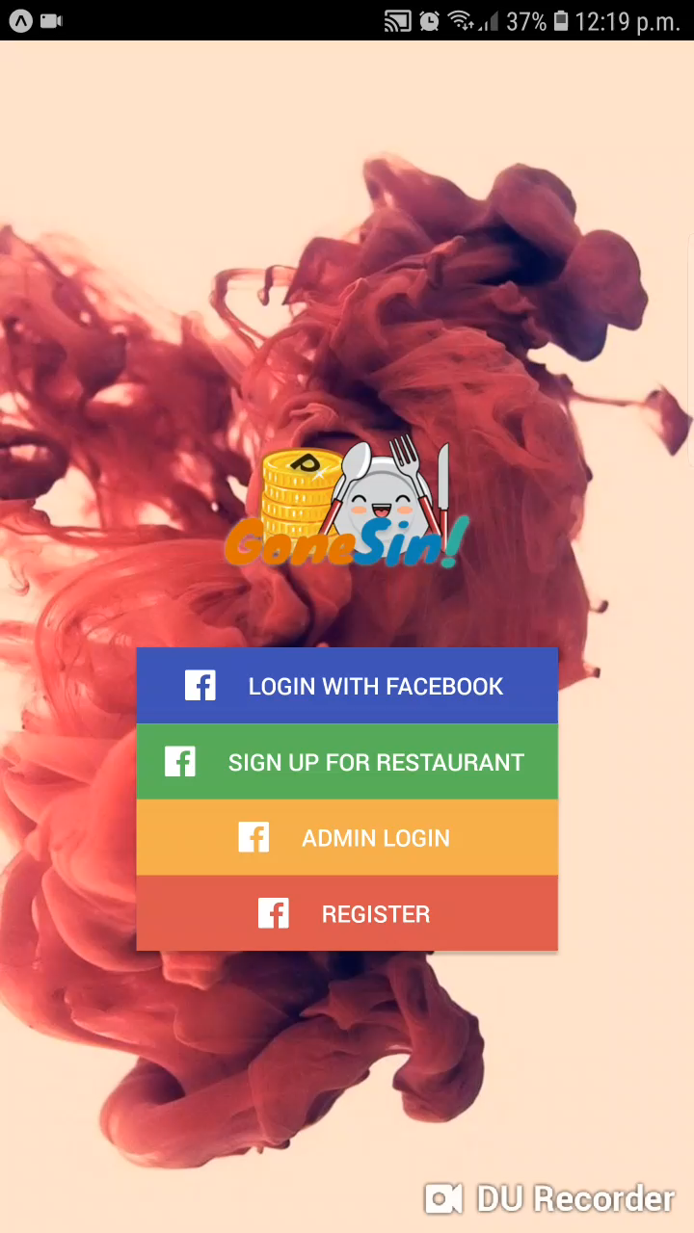
App Video

